Slide 1
Research Title: Image Annotation
Group members Name and Id:
1. Md Sehabub Zaman Pranta - 1611251042
2. Tanvir Ahmed – 1410982042
3. Jannatul Ferdouse Onny - 1631561042
4. Sadia Ahmed Tandra – 1631474042
5. Rokeya Akanda Sriti - 1620165042

Slide 2
Research Lifecyle so far
We are now here.
We started from here
Implementation of object annotation model
Again research for a good object annotation model
Comparison of two different models performance
Model implementation for two class classification
Research for a model to use
Data collection
Research about the topic

Slide 3
Different types of Image Annotation:
1. Bounding Box Annotation
2. 2D and 3D cuboid Annotation
3. Landmark Annotation
4. Polygon Annotation
5. Video Annotation and so on.

Slide 4
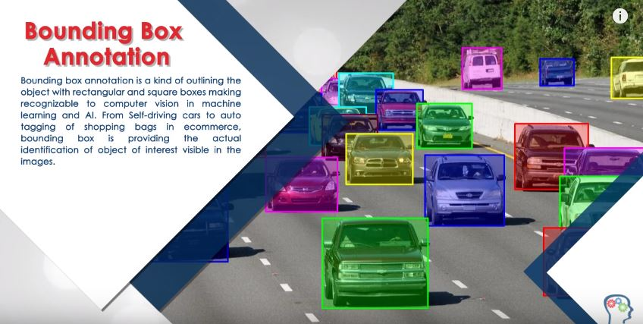
Type of Image Annotation we are going to use

Slide 5
Supervisely

Slide 6
Coding Implementation
Dataset Processing: The data set contains only the road images of Bangladesh collected from Google with 500 samples.
Data Insertion to the CNN models: Before sending data to the network, we checked image pixels by the "pixel_decider()" method, and this method returned the lowest pixel value of 340 by 512 pixels, then reshaped all the images with these pixel values. There was no validation set, as the cross-validation applied to split the data set into the train and test set only. In this case, K=5-fold stratified cross-validation has been implemented. There were 80% data for training and 20% data for testing.

Slide 7
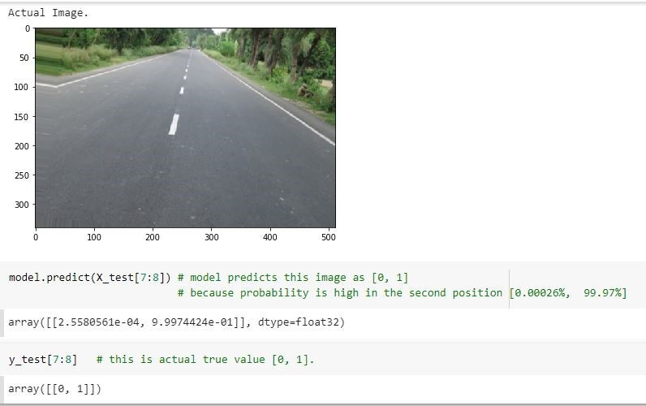
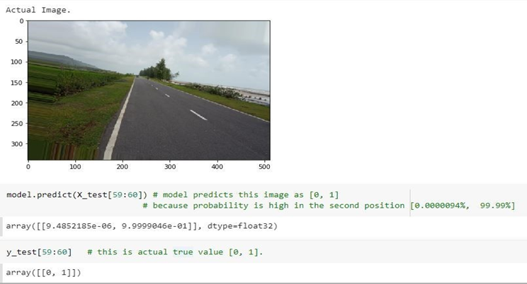
Comparison of two different models for two-class classification.
Single Image Classification of Resnet-32
Single Image Classification of Inception Network

Slide 8
Re-defining the problem.
After the one-semester research, we have found that our problem statement is “Road defect detection using image annotation.”
As we are going to work with Bangladeshi road images, more precisely, the topic would be “Bangladeshi roads defect detection.”
Solution: We are now going to find out the different defect patterns of Bangladeshi roads and train the patterns with the object detection algorithm using transfer learning.

Slide 9

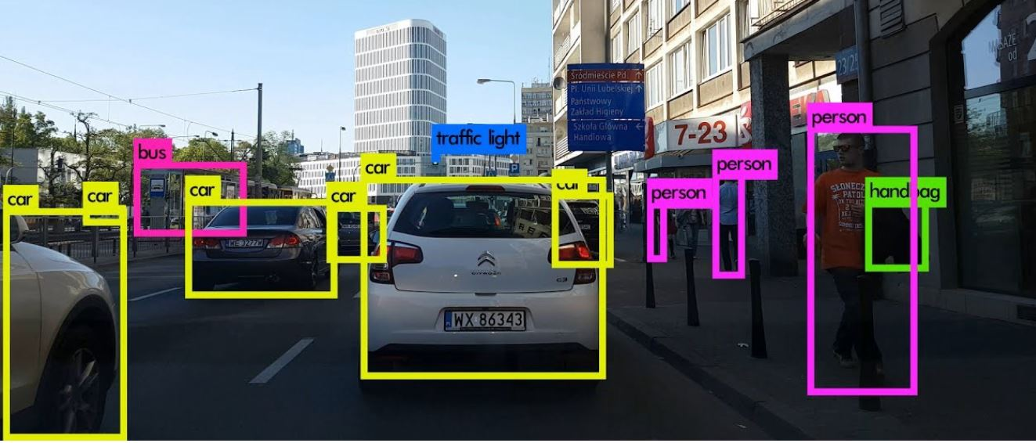
Introduction to object annotation model

Slide 10
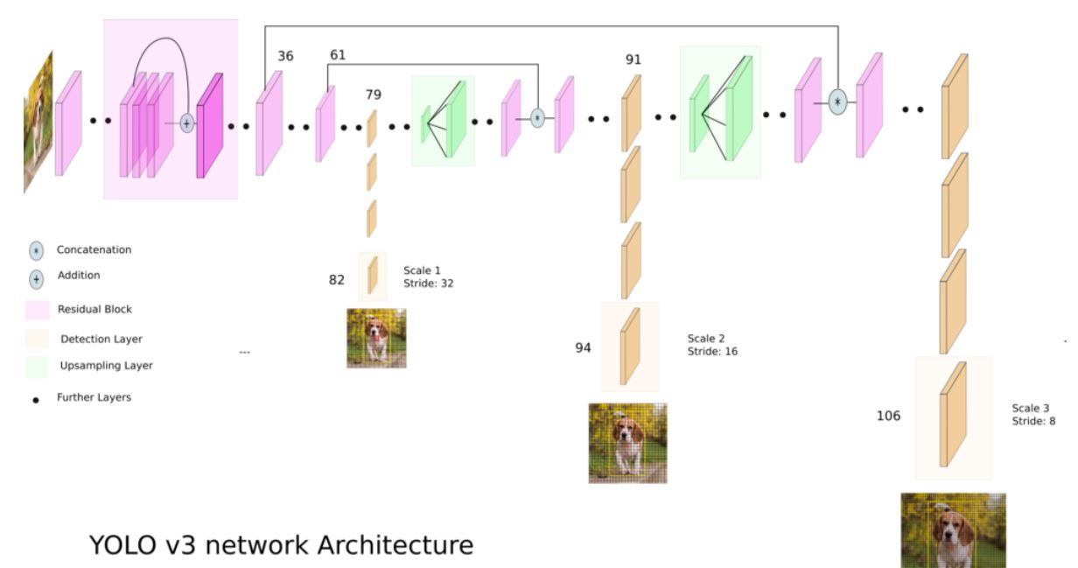
Yolo version 3 network architecture.

Slide 11
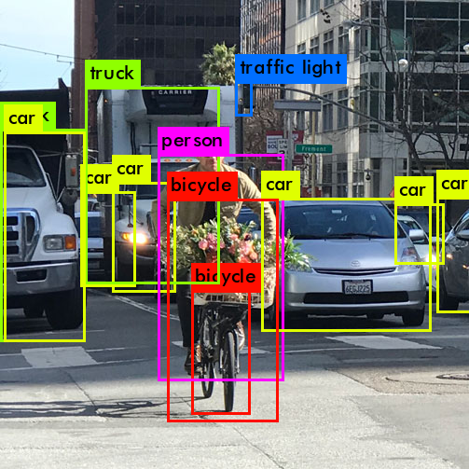
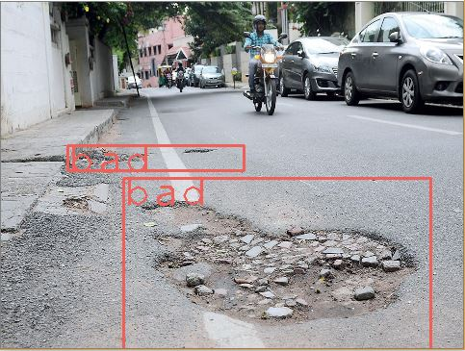
Making the model compatible with our problem.
Transfer Learning
Object Detection
Defect Detection

Slide 12
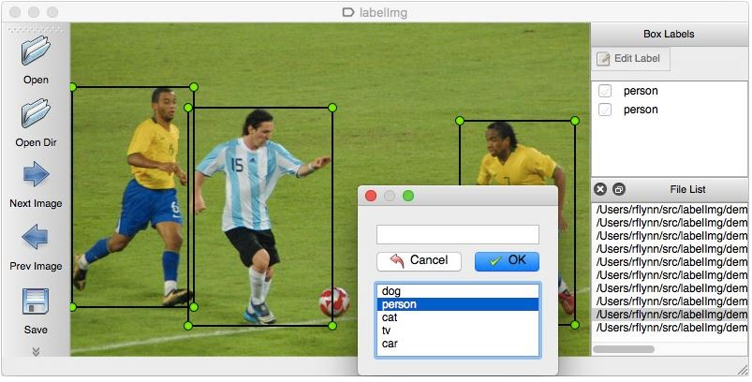
Preparing Dataset for YOLO V3
We used a tool called “labelImg” to label the image samples from our dataset.
This tool returns a text file with the object’s class label and coordinates.
For example: 0 0.470833 0.611111 0.247917 0.583333 which indicates,
<object-class> <x_center> <y_center> <width> <height>
The values generally range from 0 to 1.

Slide 13
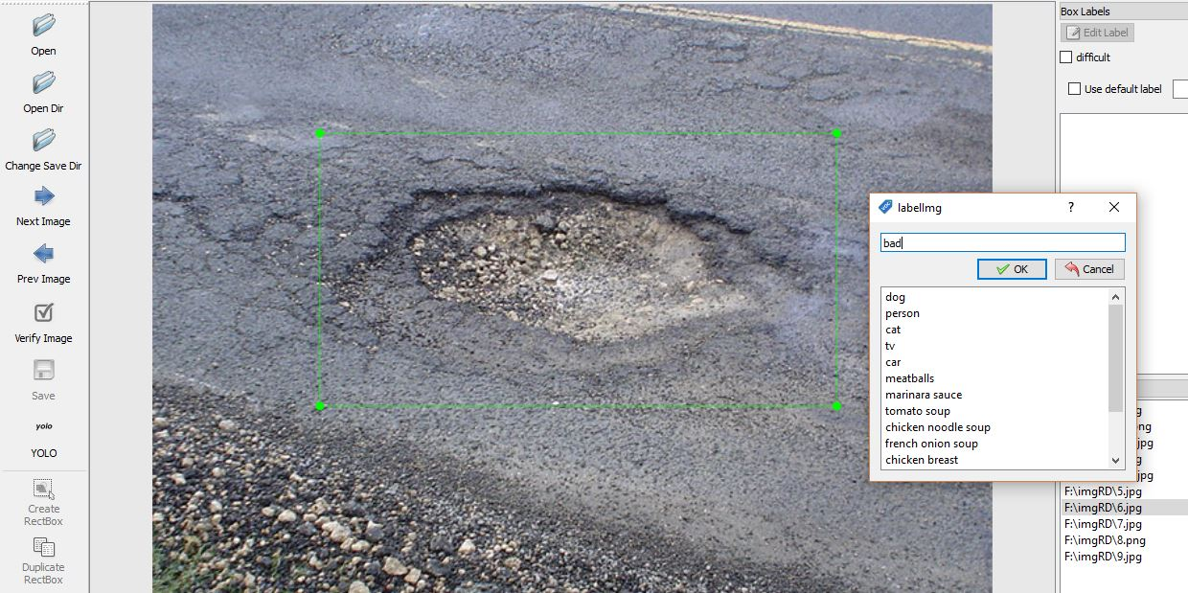
Now the time for training
Before sending data to the model, we have created only one class labeled as “bad” for defected roads.
Instead of training from the beginning, we used some pre-trained weights trained on the COCO dataset, which contained 80 classes to make our training faster.

Slide 14
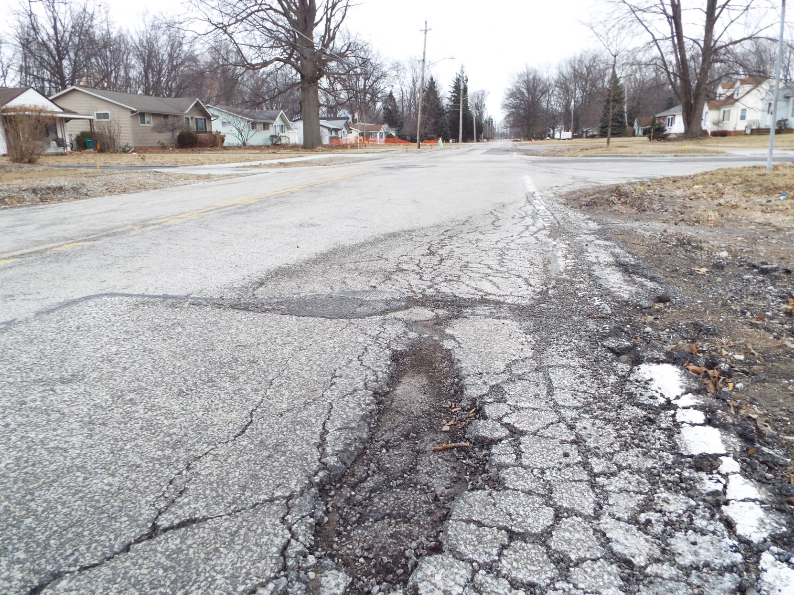
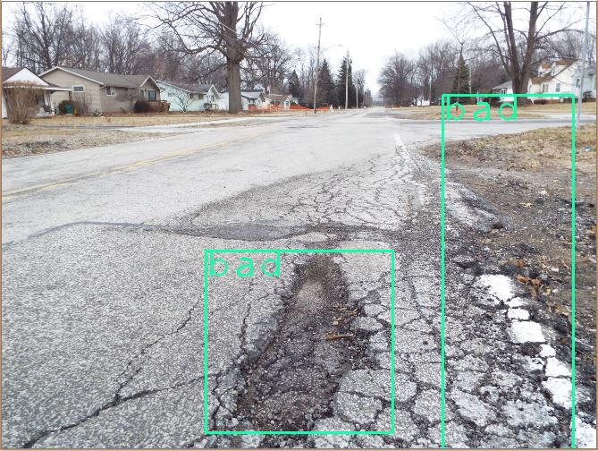
Now testing samples
Before annotation After annotation

Slide 15
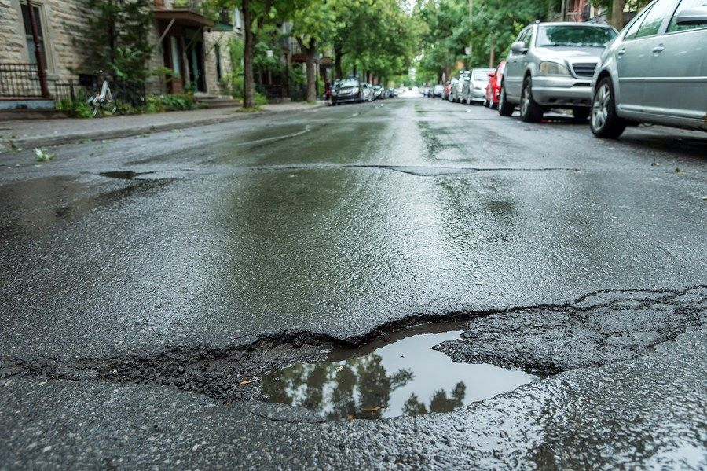
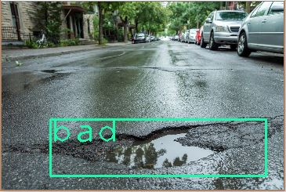
Testing cont’d
Before annotation After annotation

Slide 16
What's next?
Needs to collect more samples.
Training with more complex defect patterns.
Perform testing on Out-of-bag (OOB) samples.

Slide 17
The End! Thank You Everyone!

Slide 18
References: 1. https://towardsdatascience.com/yolo-v3-object-detection-53fb7d3bfe6b 2. https://medium.com/analytics-vidhya/implementing-yolov4-to-detect-custom-objects-using-google-colab-6691c98b15ff 3. https://tzutalin.github.io/labelImg/

